Slide 1
NLP 220 Data Science and Machine Learning Fundamentals Lecture 16
Jalal Mahmud
jumahmud@ucsc.edu

Slide 2
Character Encoding
https://www.kaggle.com/alexisbcook/character-encodings

Slide 3
Character Encoding
Character encodings are specific sets of rules for mapping from raw binary byte strings (that look like this: 0110100001101001) to characters that make up human-readable text (like "hi").
There are many different encodings, and if you tried to read in text with a different encoding than the one it was originally written in, you ended up with scrambled text called "mojibake" (said like mo-gee-bah-kay).
Here's an example of mojibake:
æ–‡å—åŒ–ã??

Slide 4
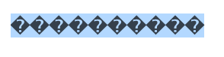
Character Encoding
You might also end up with "unknown" characters.
There are what gets printed when there's no mapping between a particular byte and a character in the encoding you're using to read your byte string in and they look like this:
Character encoding mismatches are less common today than they used to be, but it's definitely still a problem.
There are lots of different character encodings, but the main one you need to know is UTF-8.

Slide 5
Character Encoding
UTF-8 is the standard text encoding. All Python code is in UTF-8 and, ideally, all your data should be as well.
It's when things aren't in UTF-8 that you run into trouble.
It was pretty hard to deal with encodings in Python 2, but thankfully in Python 3 it's a lot simpler.
There are two main data types you'll encounter when working with text in Python 3.
One is is the string, which is what text is by default.

Slide 6
Character Encoding
# start with a string
before = "This is the euro symbol: €"
# check to see what datatype it is
type(before)

Slide 7
Character Encoding
The encode() method returns an encoded version of the string.
Default encoding is the current default string encoding. The errors may be given to set a different error handling scheme.
Syntax
Following is the syntax for encode() method −
str.encode(encoding = 'UTF-8',errors = 'strict')

Slide 8
Character Encoding
The other data is the bytes data type, which is a sequence of integers.
You can convert a string into bytes by specifying which encoding it's in:
# encode it to a different encoding, replacing characters that raise errors
after = before.encode("utf-8", errors="replace")
# check the type
type(after)
print(before)
print(after)
This is the euro symbol: €
b'This is the euro symbol: \xe2\x82\xac'

Slide 9
Character Encoding
If you look at a bytes object, you'll see that it has a b in front of it, and then maybe some text after.
That's because bytes are printed out as if they were characters encoded in ASCII.
Here you can see that our euro symbol has been replaced with some mojibake that looks like "\xe2\x82\xac" when it's printed as if it were an ASCII string.

Slide 10
Character Encoding
When we convert our bytes back to a string with the correct encoding, we can see that our text is all there correctly, which is great! :)
# convert it back to utf-8
print(after.decode("utf-8"))
This is the euro symbol: €

Slide 11
Character Encoding
However, when we try to use a different encoding to map our bytes into a string, we get an error.
This is because the encoding we're trying to use doesn't know what to do with the bytes we're trying to pass it.
You need to tell Python the encoding that the byte string is actually supposed to be in.
# try to decode our bytes with the ascii encoding print(after.decode("ascii"))

Slide 12
Character Encoding
Analogy:
You can think of different encodings as different ways of recording music.
You can record the same music on a CD, cassette tape or 8-track.
While the music may sound more-or-less the same, you need to use the right equipment to play the music from each recording format.
The correct decoder is like a cassette player or a CD player. If you try to play a cassette in a CD player, it just won't work.

Slide 13
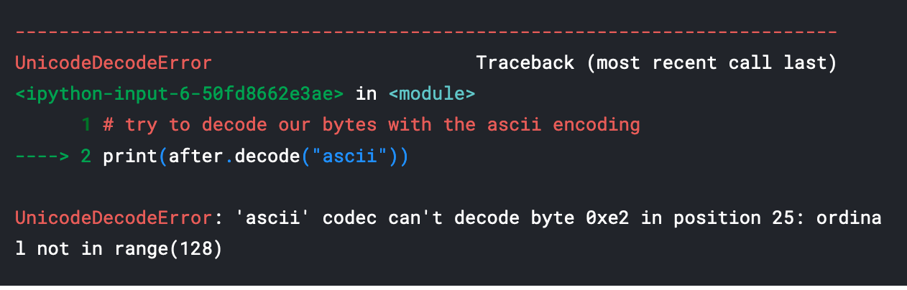
Character Encoding
# try to decode our bytes with the ascii encoding print(after.decode("ascii"))

Slide 14
Character Encoding
We can also run into trouble if we try to use the wrong encoding to map from a string to bytes.
Strings are UTF-8 by default in Python 3, so if we try to treat them like they were in another encoding we'll create problems.
For example, if we try to convert a string to bytes for ASCII using encode(), we can ask for the bytes to be what they would be if the text was in ASCII.
Since our text isn't in ASCII, though, there will be some characters it can't handle.

Slide 15
Character Encoding
We can automatically replace the characters that ASCII can't handle.
If we do that, however, any characters not in ASCII will just be replaced with the unknown character.
Then, when we convert the bytes back to a string, the character will be replaced with the unknown character.
The dangerous part about this is that there's not way to tell which character it should have been.
That means we may have just made our data unusable!

Slide 16
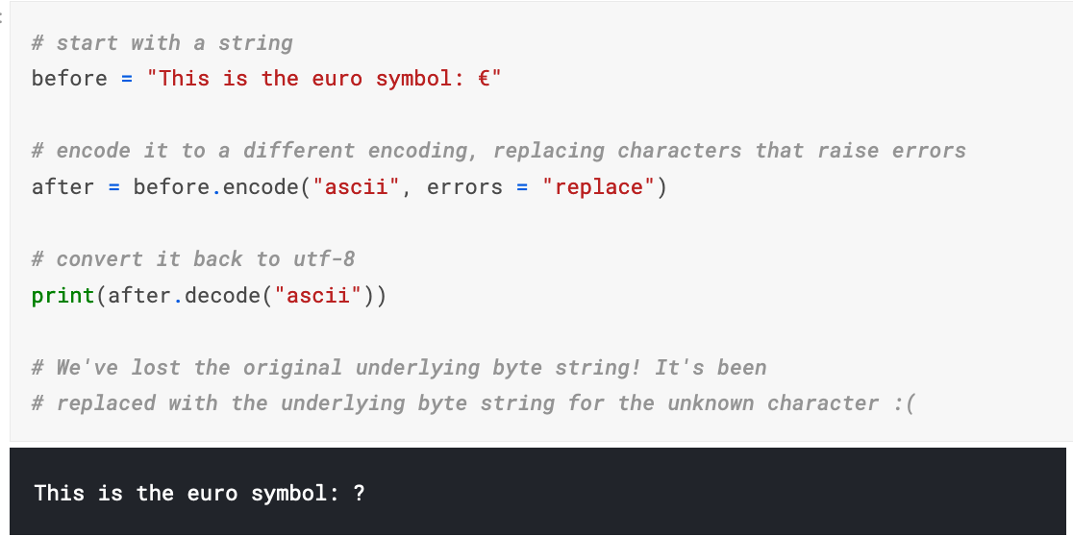
Character Encoding
This is bad and we want to avoid doing it! It's far better to convert all our text to UTF-8 as soon as we can and keep it in that encoding. The best time to convert non UTF-8 input into UTF-8 is when you read in files, which we'll talk about next.

Slide 17
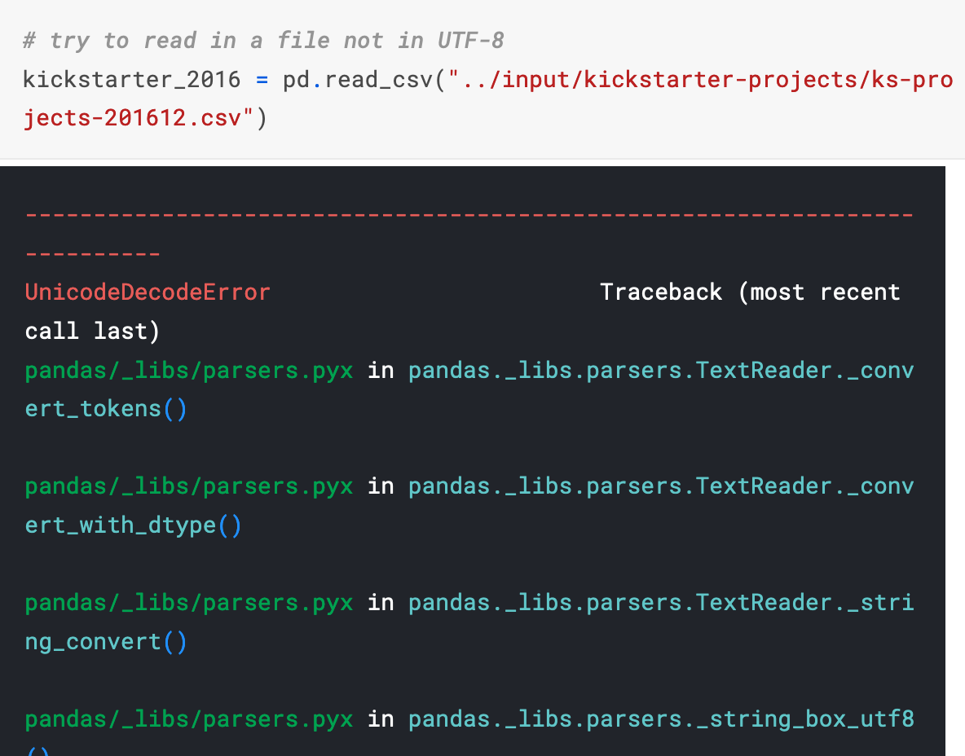
Reading in files with encoding problems
Most files you'll encounter will probably be encoded with UTF-8. This is what Python expects by default, so most of the time you won't run into problems. However, sometimes you'll get an error like this:

Slide 18
Reading in files with encoding problems
Notice that we get the same UnicodeDecodeError we got when we tried to decode UTF-8 bytes as if they were ASCII!
This tells us that this file isn't actually UTF-8. We don't know what encoding it actually is though.
One way to figure it out is to try and test a bunch of different character encodings and see if any of them work.
A better way, though, is to use the chardet module to try and automatically guess what the right encoding is. It's not 100% guaranteed to be right, but it's usually faster than just trying to guess.

Slide 19
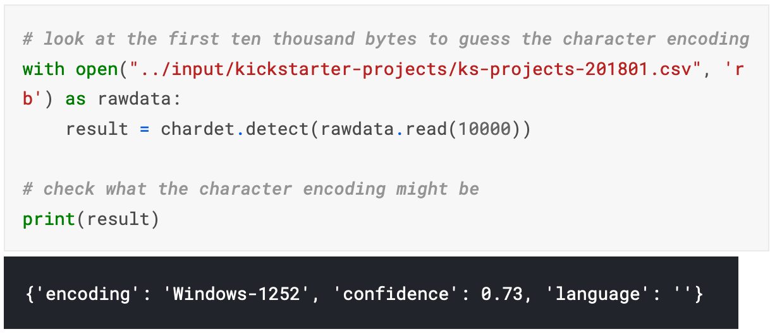
Reading in files with encoding problems

Slide 20
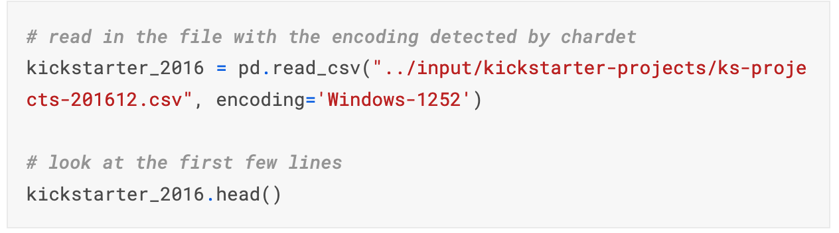
Reading in files with encoding problems

Slide 21
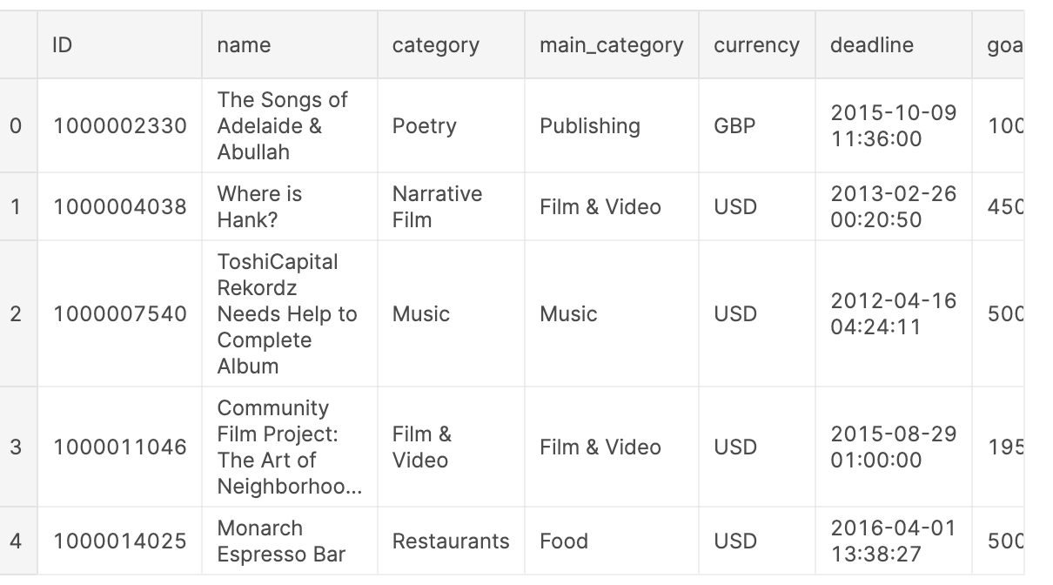
Reading in files with encoding problems

Slide 22
Reading in files with encoding problems
What if the encoding chardet guesses isn't right?
Since chardet is basically just a fancy guesser, sometimes it will guess the wrong encoding.
One thing you can try is looking at more or less of the file and seeing if you get a different result and then try that.

Slide 23
Data Sampling
https://towardsdatascience.com/probability-sampling-with-python-8c977ad78664

Slide 24
Sampling
What is Sampling?
Sampling is the process of selecting a random number of units from a known population.
It allows obtaining information and drawing conclusions about a population based on the statistics of such units (i.e. the sample), without the need of having to study the entire population.

Slide 25
Sampling
Why is Sampling Used?
Sampling is performed for multiple reasons, including:
Cases where it is impossible to study the entire population due to its size
Cases where the sampling process involves samples destructive testing
Cases where there are time a and costs constrains

Slide 26
Sampling Techniques
Sampling Techniques
There are two types of sampling techniques:
Probability sampling: cases when every unit from a given population has the same probability of being selected.
This technique includes:
- simple random sampling
- systematic sampling
- cluster sampling and
- stratified random sampling.

Slide 27
Sampling Techniques
Non-probability sampling: cases when units from a given population do not have the same probability of being selected.
This technique includes:
- convenience sampling
- quota sampling
- judgement sampling and
- snowball sampling.
In comparison with probability sampling, this technique is more prone to end up with a non-representative sample group, leading to wrong conclusions about the population.

Slide 28
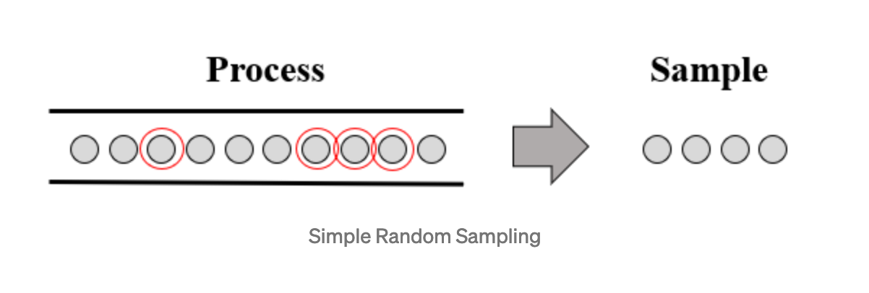
Simple Random Sampling
Simple Random Sampling
As its name suggests, the simple random sampling method selects random samples from a process or population where every unit has the same probability of getting selected.
This is the most direct method of probability sampling.

Slide 29
Simple Random Sampling
Pandas sample() is used to generate a sample random row or column from the function caller data frame.
Syntax:
DataFrame.sample(n=None, frac=None, replace=False, weights=None, random_state=None, axis=None)
n: int value, Number of random rows to generate. frac: Float value, Returns (float value * length of data frame values ). frac cannot be used with n. replace: Boolean value, return sample with replacement if True.
weightsstr or ndarray-like, optionalDefault ‘None’ results in equal probability weighting. If passed a Series, will align with target object on index.
random_state: int value or numpy.random.RandomState, optional. if set to a particular integer, will return same rows as sample in every iteration. axis: 0 or ‘row’ for Rows and 1 or ‘column’ for Columns.

Slide 30
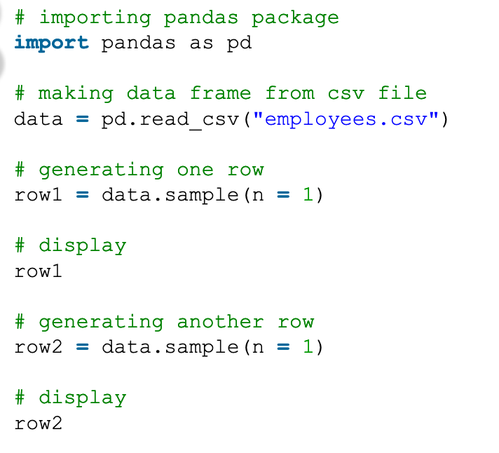
Simple Random Sampling
https://www.geeksforgeeks.org/python-pandas-dataframe-sample/

Slide 31
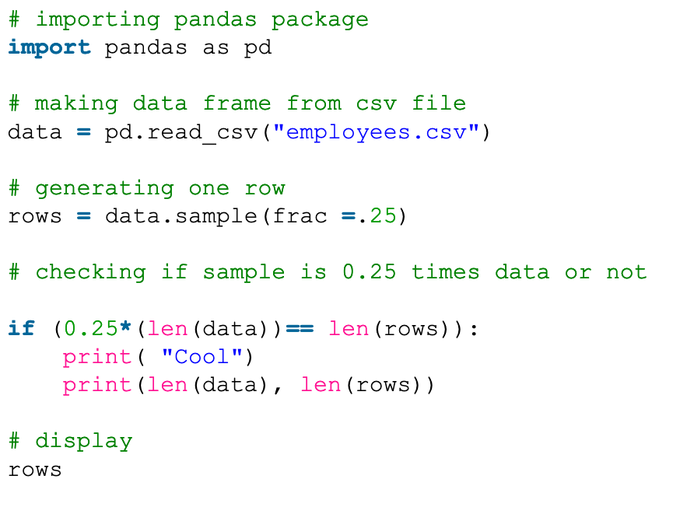
Simple Random Sampling
https://www.geeksforgeeks.org/python-pandas-dataframe-sample/

Slide 32
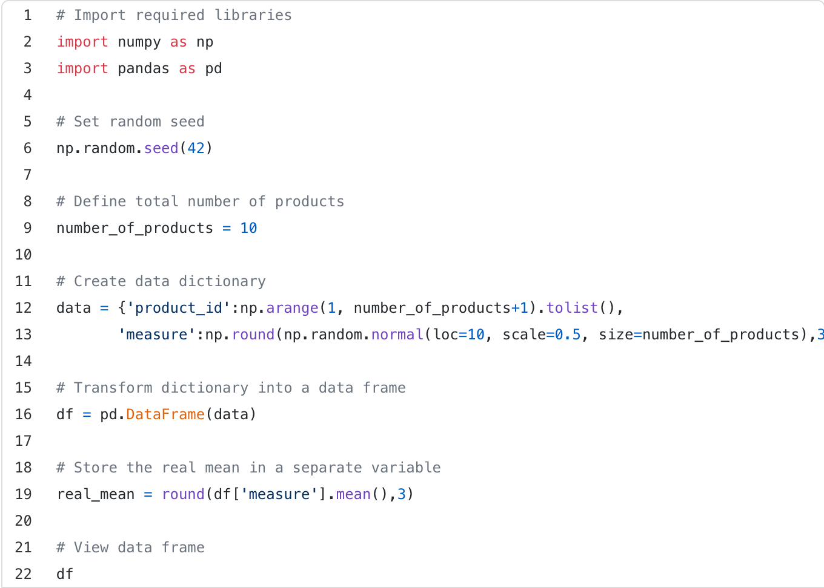
Simple Random Sampling
Let’s obtain samples from a set of 10 products using probability sampling to determine the population mean of a particular measure of interest

Slide 33
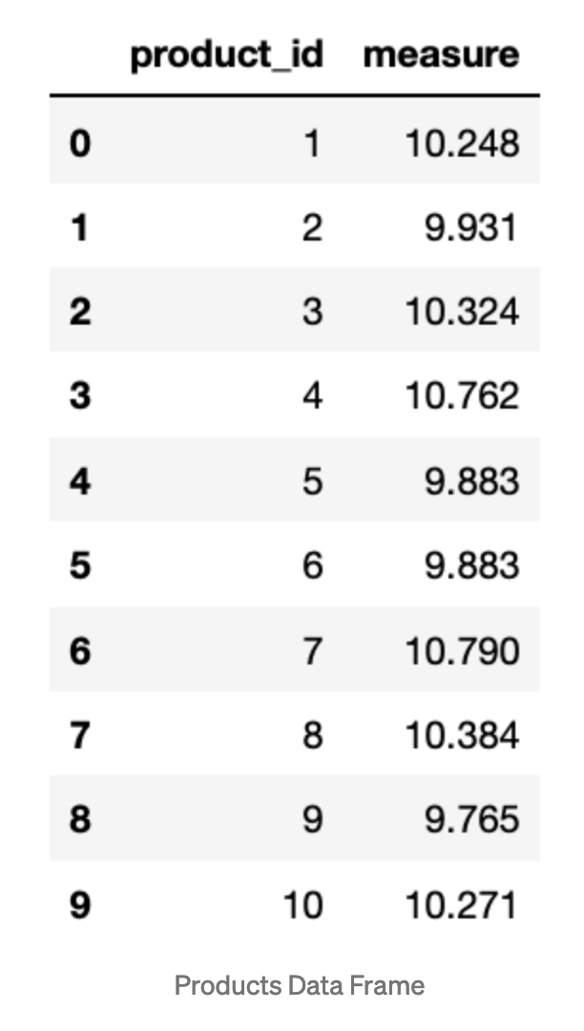
Simple Random Sampling

Slide 34
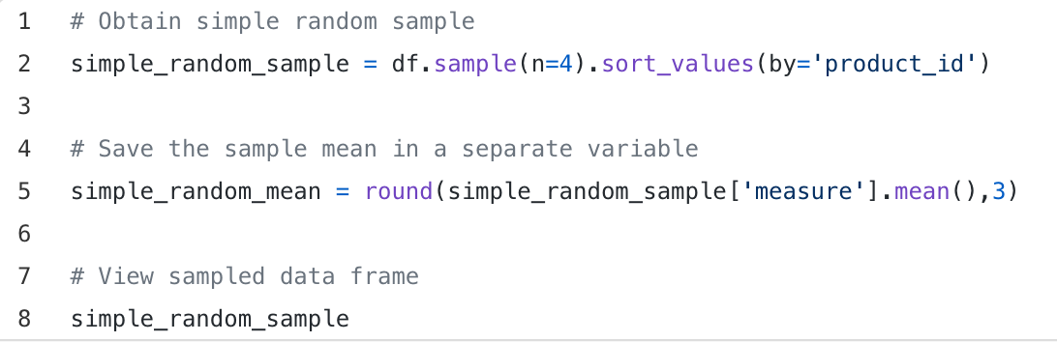
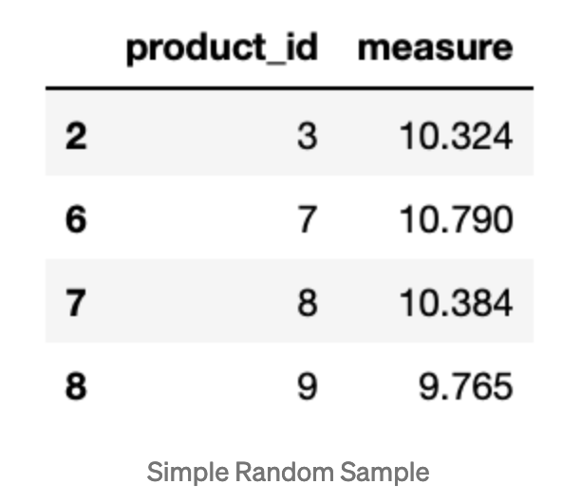
Simple Random Sampling

Slide 35
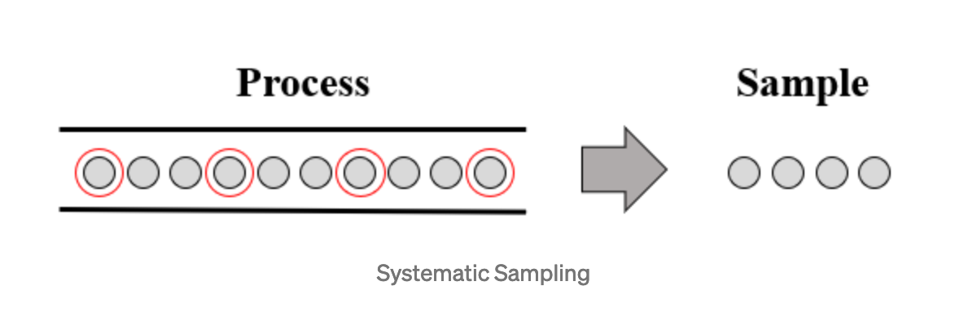
Systematic Sampling
Systematic Sampling
The systematic sampling method selects units based on a fixed sampling interval (i.e. every nth unit is selected from a given process or population).
This sampling method tends to be more effective than the simple random sampling method.

Slide 36
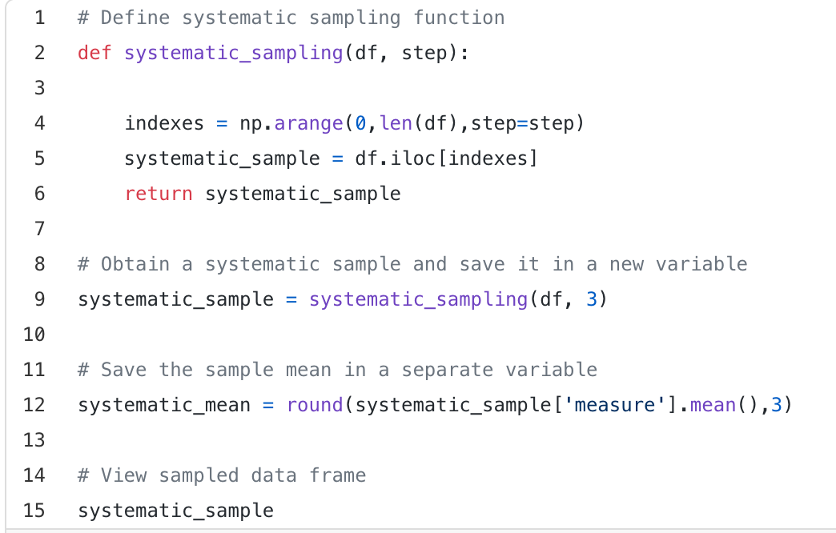
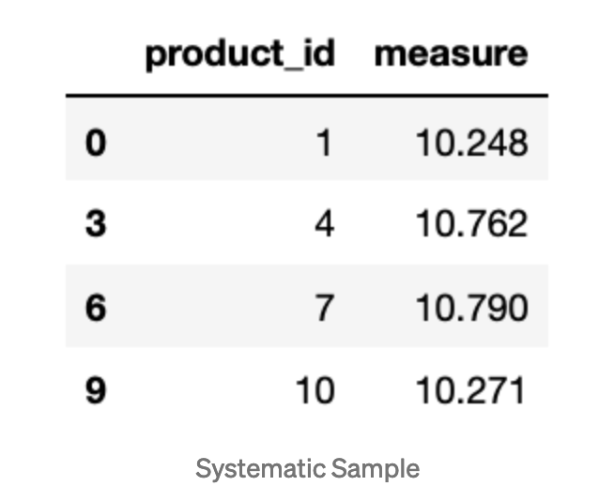
Systematic Sampling
Systematic Sampling

Slide 37
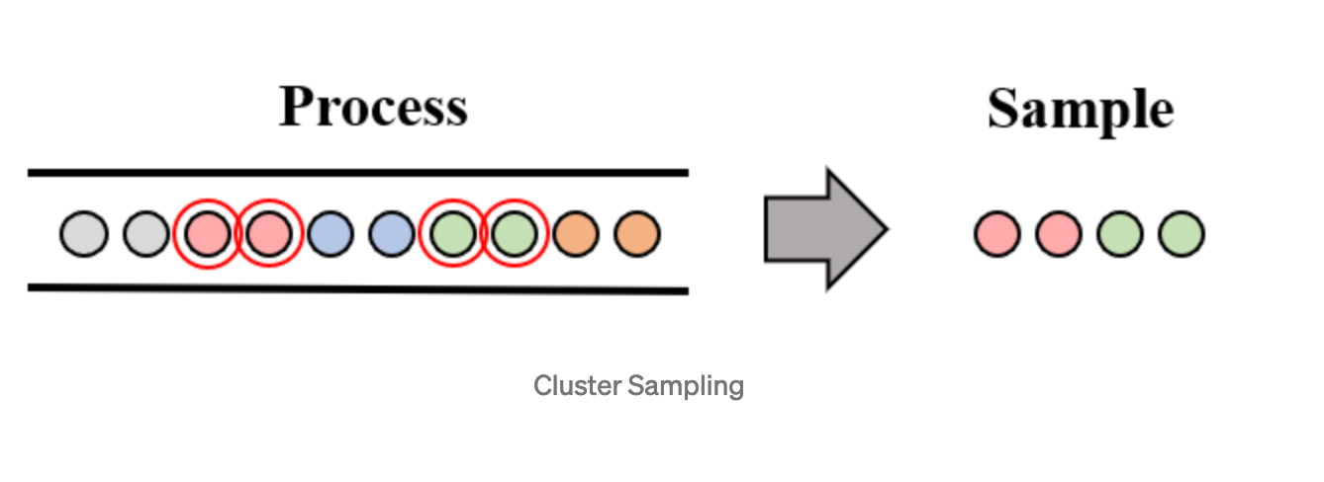
Cluster Sampling
Cluster Sampling
The cluster sampling method divides the population in clusters of equal size n and selects clusters every Tth time.

Slide 38
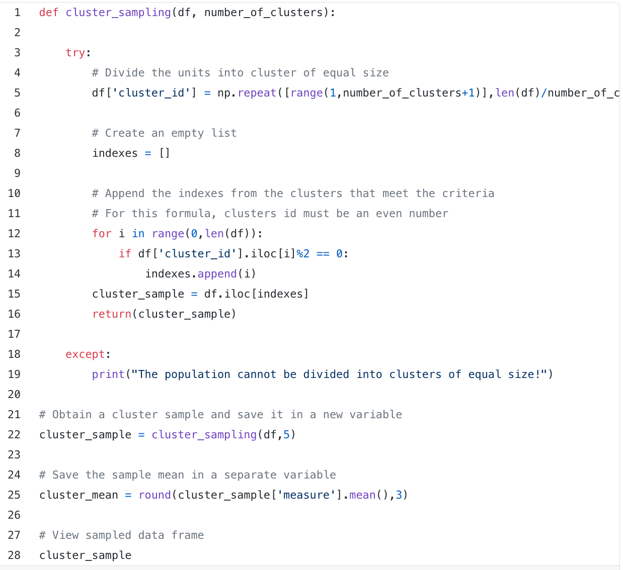
Cluster Sampling
Cluster Sampling

Slide 39
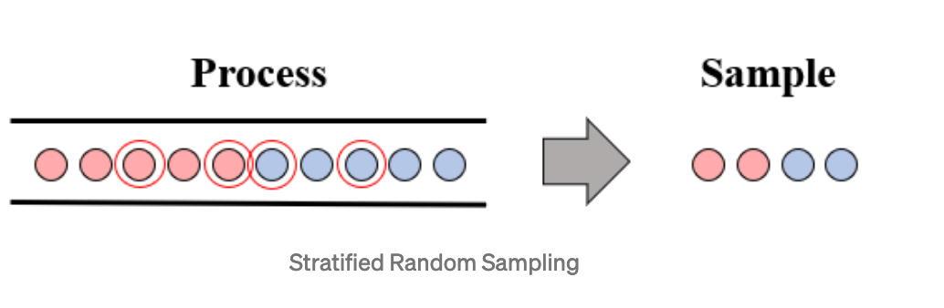
Stratified Random Sampling
Stratified Random Sampling
The stratified random sampling method divides the population in subgroups (i.e. strata) and selects random samples where every unit has the same probability of getting selected.

Slide 40
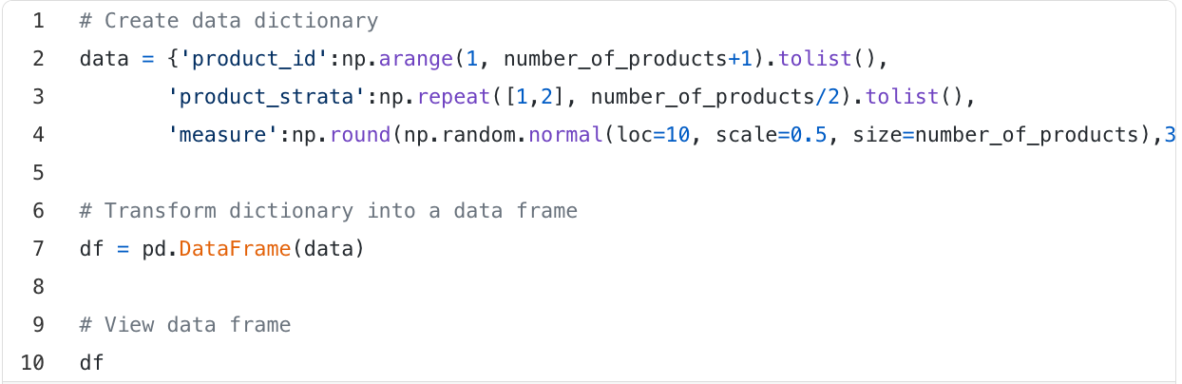
Stratified Random Sampling
Stratified Random Sampling

Slide 41
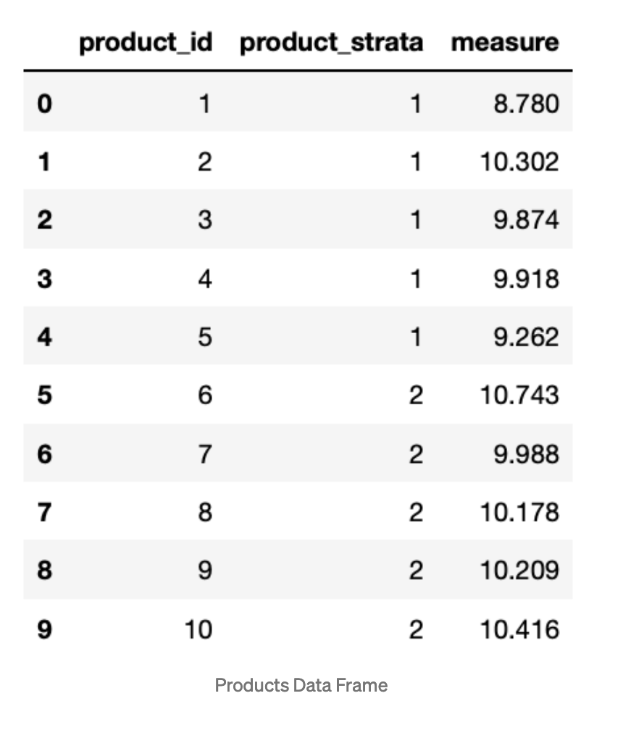
Stratified Random Sampling
Stratified Random Sampling

Slide 42
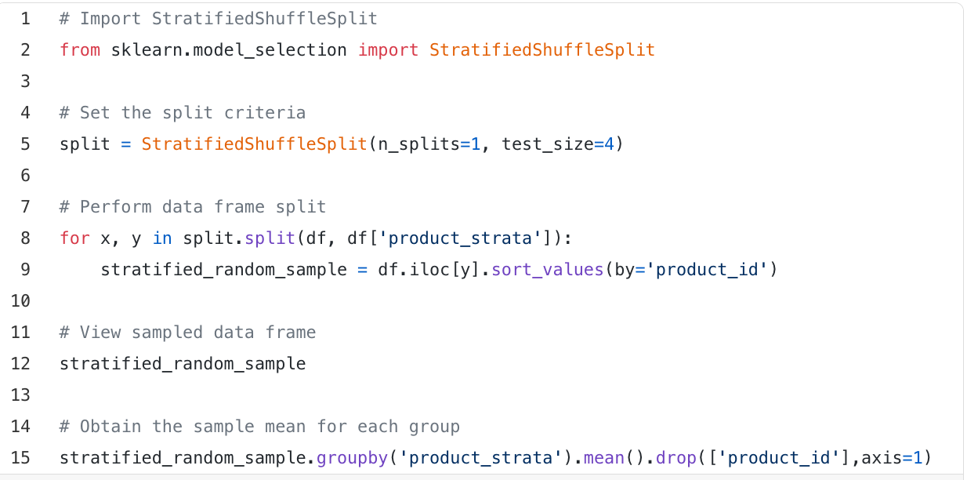
Stratified Random Sampling
Stratified Random Sampling

Slide 43
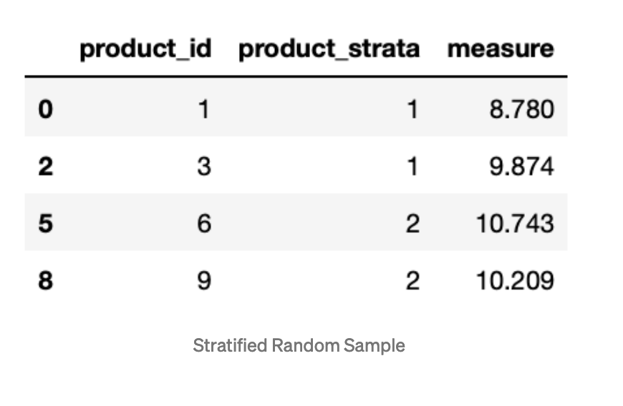
Stratified Random Sampling
Stratified Random Sampling

Slide 44
More on Data Sampling

Slide 45
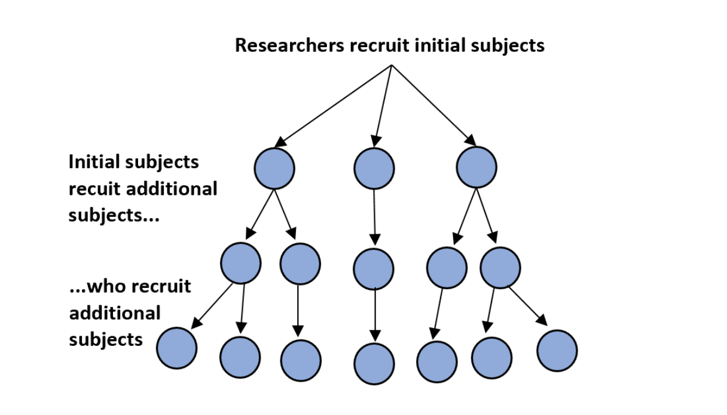
Snowball Sampling
https://www.statology.org/snowball-sampling/

Slide 46
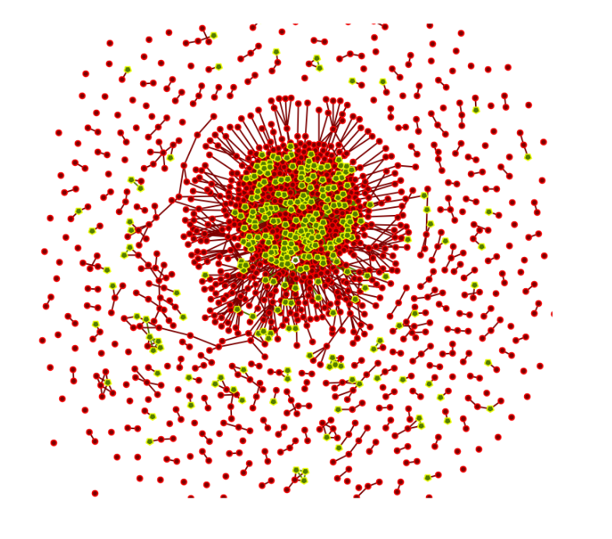
Snowball Sampling
http://www.casos.cs.cmu.edu/events/summer_institute/2017/reading_list/6.7%20collecting_twitter_data.pdf

Slide 47
Using Snowball Sampling to collect Twitter data
Snowball sampling, often builds on predefined lists of user accounts as starting points (Rieder), often defined by experts, manual collections or existing lists, which are then extended through “snowballing” or triangulation, often via medium-specific relations such topic or activity based user groups, dissemination of content.
https://journal.media-culture.org.au/index.php/mcjournal/article/view/620

Slide 48
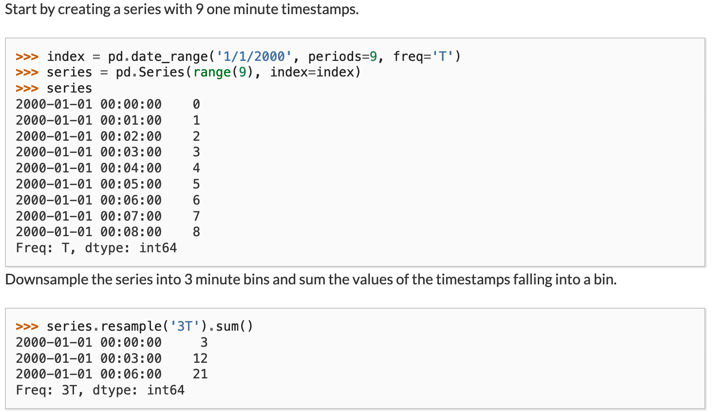
Resampling Technique
https://pandas.pydata.org/pandas-docs/stable/reference/api/pandas.DataFrame.resample.html

Slide 49
Tackling Class Imbalance using Resampling
https://www.kaggle.com/rafjaa/resampling-strategies-for-imbalanced-datasets

Slide 50
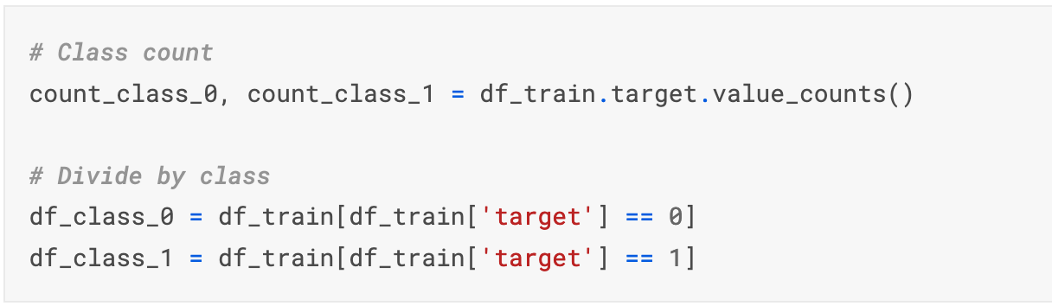
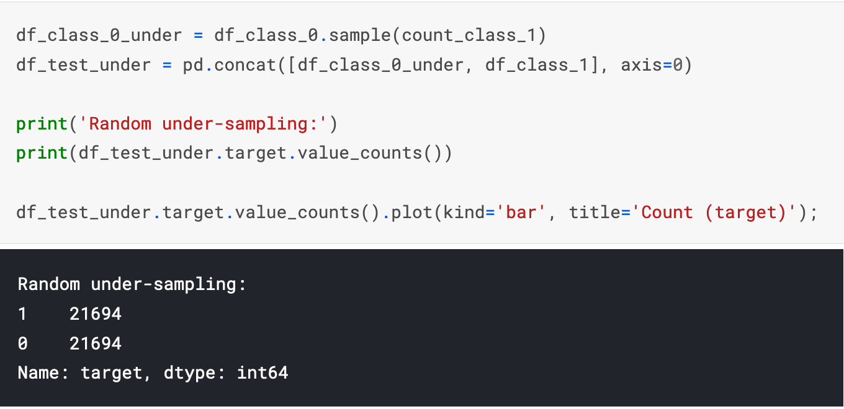
Tackling Class Imbalance - Random under-sampling

Slide 51
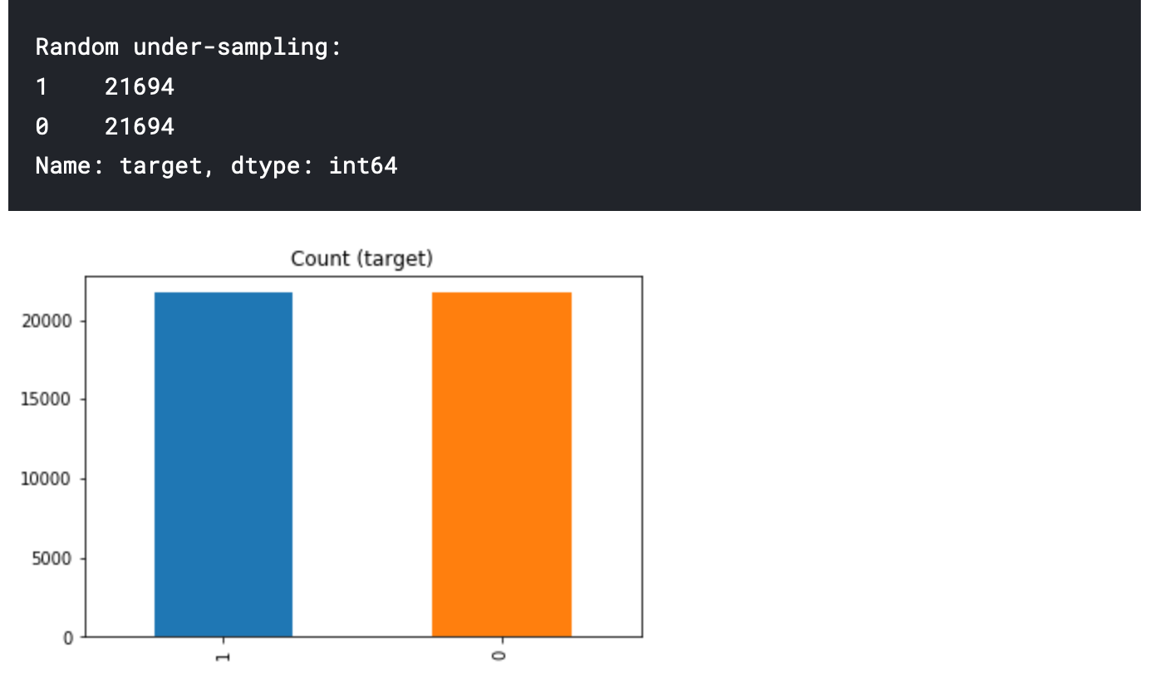
Tackling Class Imbalance using Resampling

Slide 52
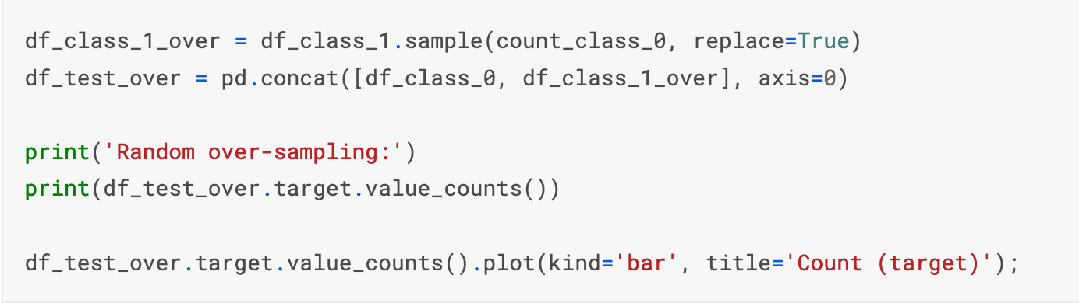
Tackling Class Imbalance - Random over-sampling

Slide 53
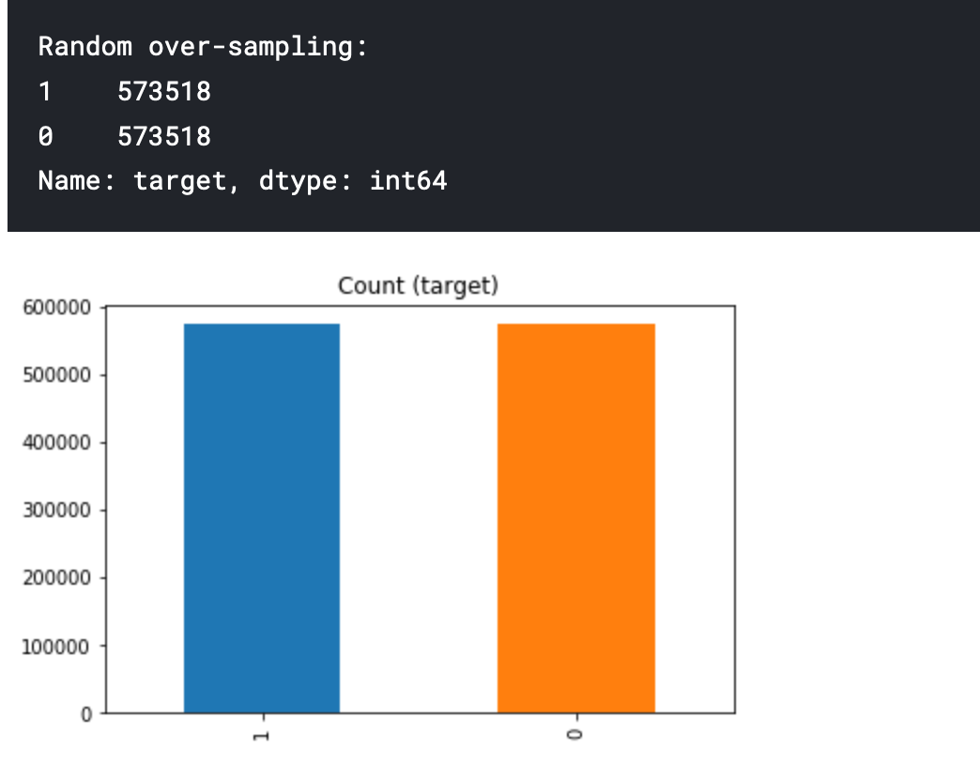
Tackling Class Imbalance using Resampling

Slide 54
Tackling Class Imbalance using Resampling
https://www.kaggle.com/shahules/tackling-class-imbalance

Slide 55
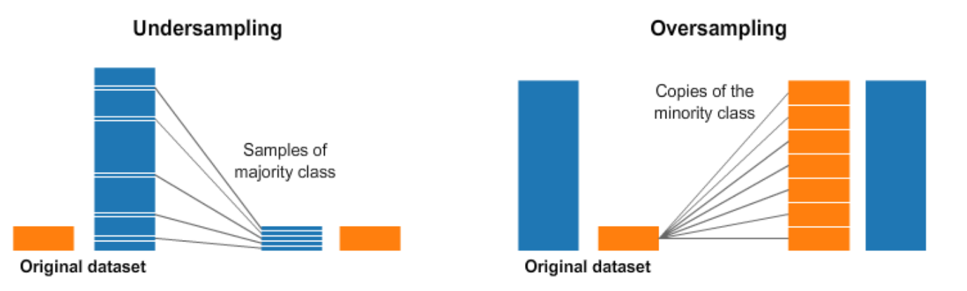
Resampling
A widely adopted technique for dealing with highly unbalanced datasets is called resampling.
It consists of removing samples from the majority class (under-sampling) and / or adding more examples from the minority class (over-sampling).
https://www.kaggle.com/shahules/tackling-class-imbalance

Slide 56
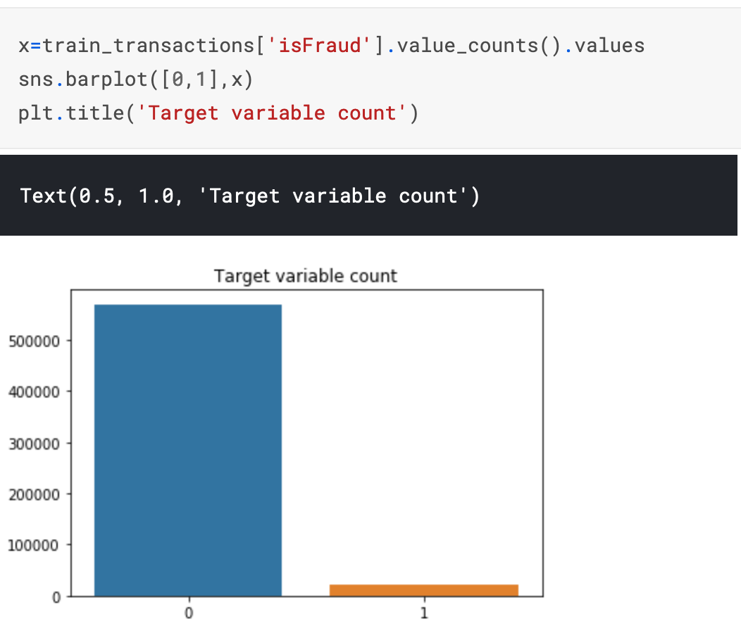
Resampling Technique
Oversample minority class
https://www.kaggle.com/shahules/tackling-class-imbalance

Slide 57
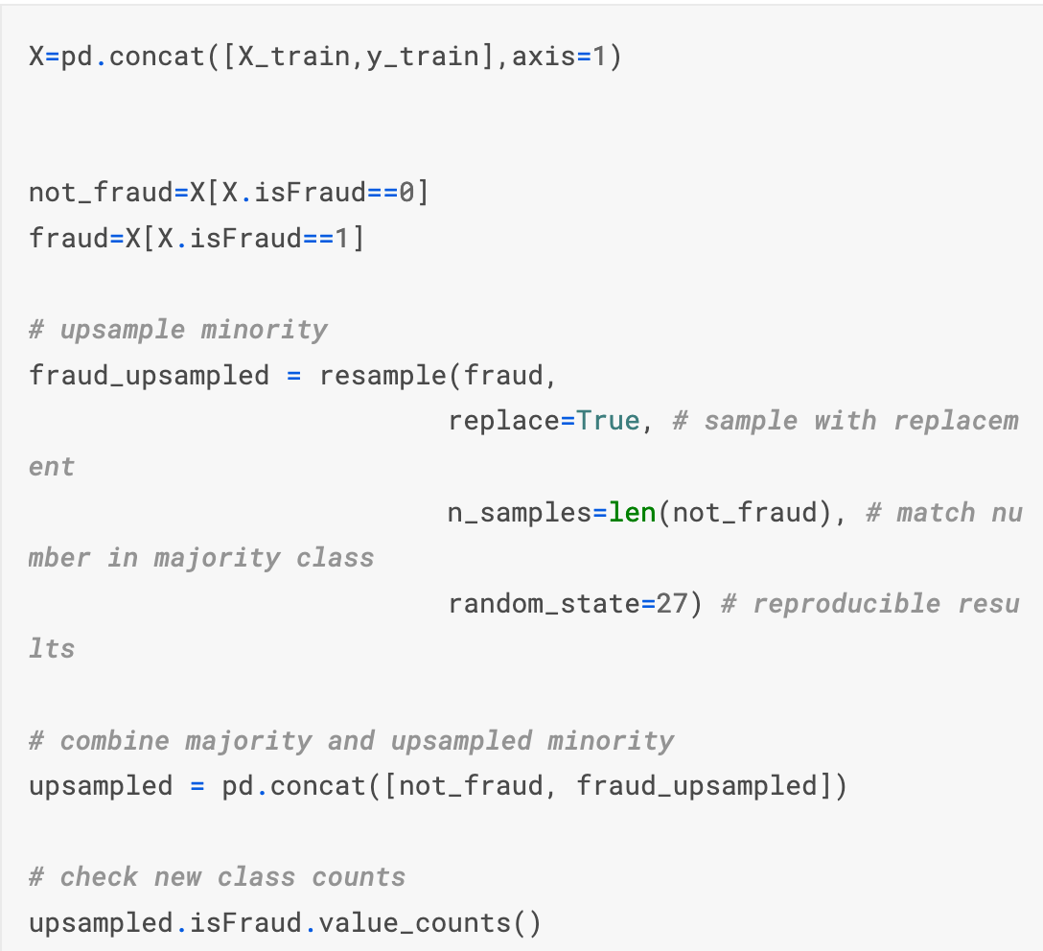
Resampling Technique using sklearn
https://www.kaggle.com/shahules/tackling-class-imbalance

Slide 58
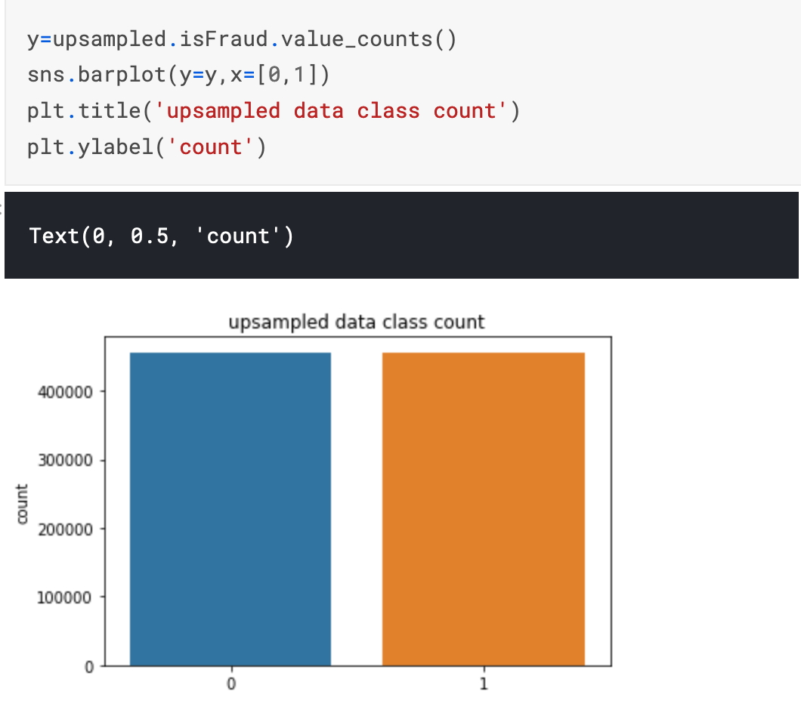
Resampling Technique using sklearn
https://www.kaggle.com/shahules/tackling-class-imbalance

Slide 59
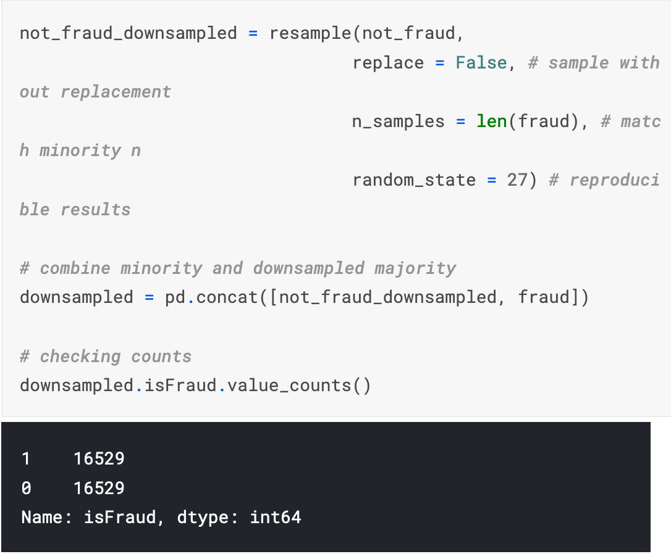
Resampling Technique using sklearn
Undersample majority class
https://www.kaggle.com/shahules/tackling-class-imbalance

Slide 60
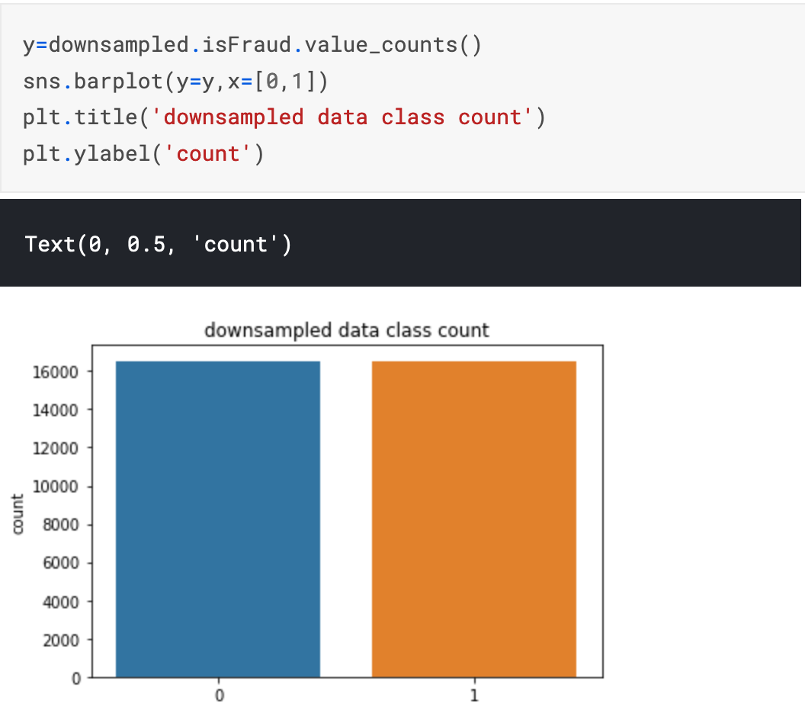
Resampling Technique using sklearn
Undersample majority class
https://www.kaggle.com/shahules/tackling-class-imbalance

Slide 61
Python imbalanced-learn module
A number of more sophisticated resampling techniques have been proposed in the scientific literature.
For example, we can cluster the records of the majority class, and do the under-sampling by removing records from each cluster, thus seeking to preserve information.
In over-sampling, instead of creating exact copies of the minority class records, we can introduce small variations into those copies, creating more diverse synthetic samples.
Python library imbalanced-learn
https://www.kaggle.com/rafjaa/resampling-strategies-for-imbalanced-datasets

Slide 62
Synthetic Sampling
Generating “new” data similar to the minority samples.
The classic method SMOTE uses K nearest neighbors to select similar samples for randomly selected minority samples, and obtain new samples by linear interpolation.

Slide 63
Uncertainty Sampling

Slide 64
Uncertainty Sampling
Uncertainty Sampling is a strategy for identifying unlabeled items that are near a decision boundary in your current Machine Learning model.
Four approaches to Uncertainty Sampling:
Least Confidence Sampling: difference between the most confident prediction and 100% confidence
Margin of Confidence Sampling: difference between the top two most confident predictions
Ratio of Confidence Sampling: ratio between the top two most confident predictions.
Entropy-based Sampling: difference between all predictions, as defined by information theory. Entropy-based Sampling would capture how much every confidence differed from each other.

Slide 65
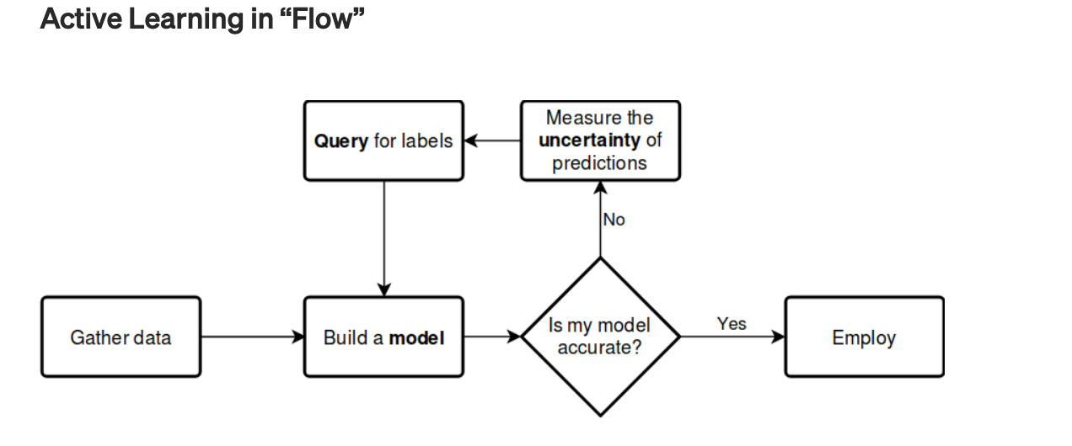
Uncertainty Sampling
Uncertainty Sampling is a strategy for identifying unlabeled items that are near a decision boundary in your current Machine Learning model.

Slide 66
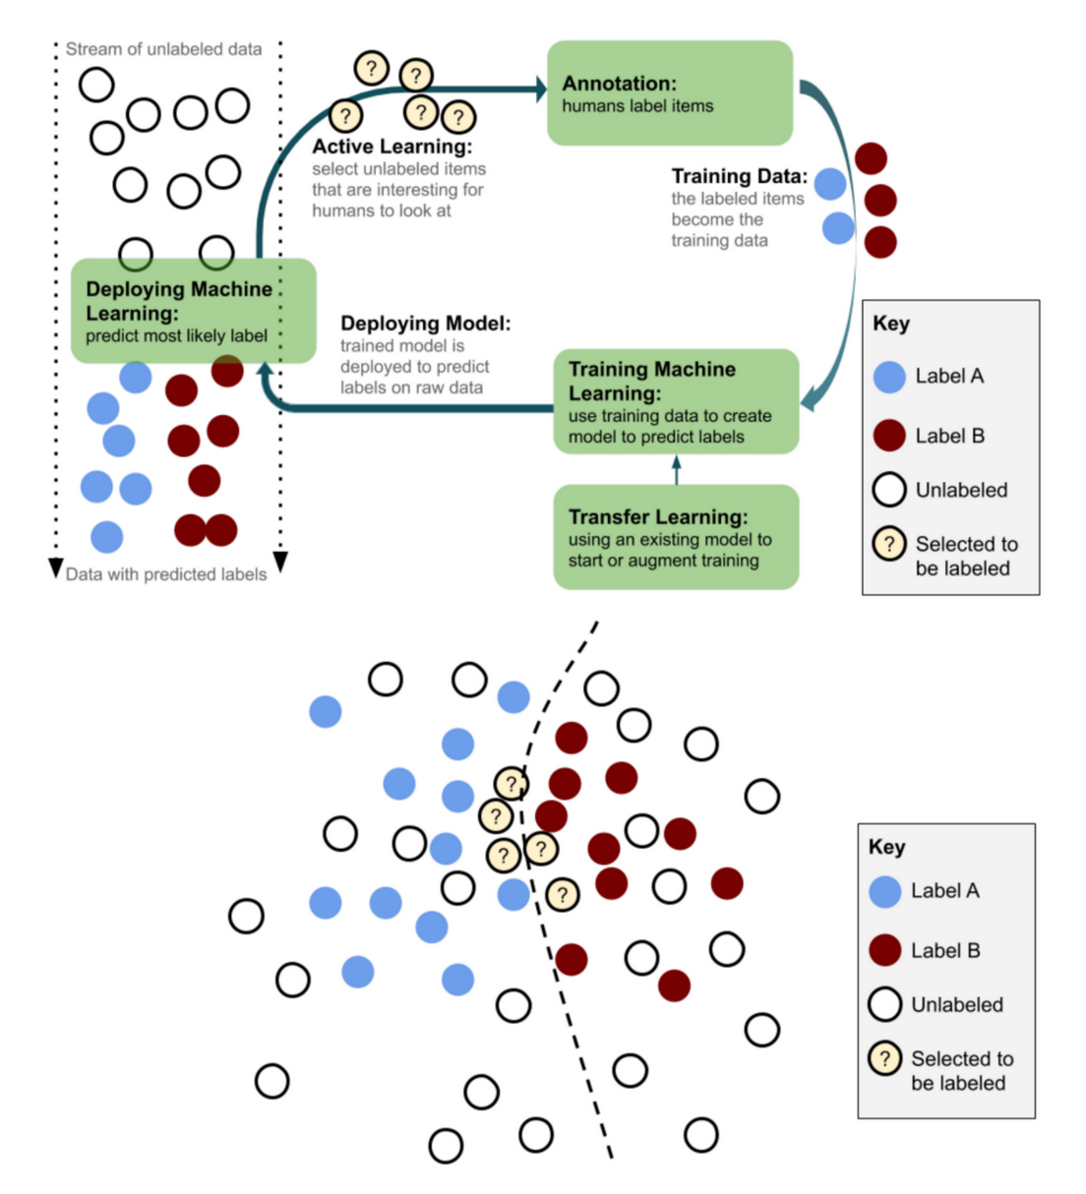
Uncertainty Sampling

Slide 67
Uncertainty Sampling
There are many algorithms for calculating uncertainty following the same principles:
Apply the uncertainty sampling algorithm to a large pool of predictions in order to generate a single uncertainty score for each item.
Rank the predictions by the uncertainty score.
Select the top N most uncertain items for human review
Obtain human labels for the top N items, retrain the model with those items, and iterate on the processes.

Slide 68
Data Sampling using Semi-supervision

Slide 69
Semi Supervised Sampling
Semi-supervised learning is an approach to machine learning that combines a small amount of labeled data with a large amount of unlabeled data during training.
It is possible to sample training data from unlabeled pool using the trained model learned from labeled data

Slide 70
Data Sampling Approach – Additional Details
https://imbalanced-learn.readthedocs.io/en/stable/over_sampling.html#smote-adasyn

Slide 71
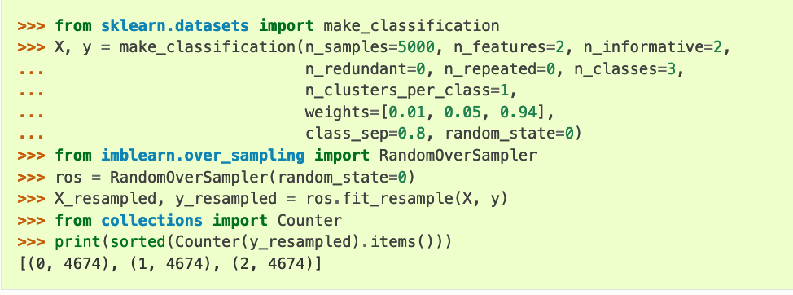
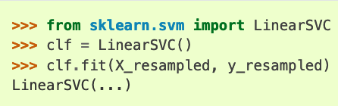
Naïve Random Oversampling

Slide 72
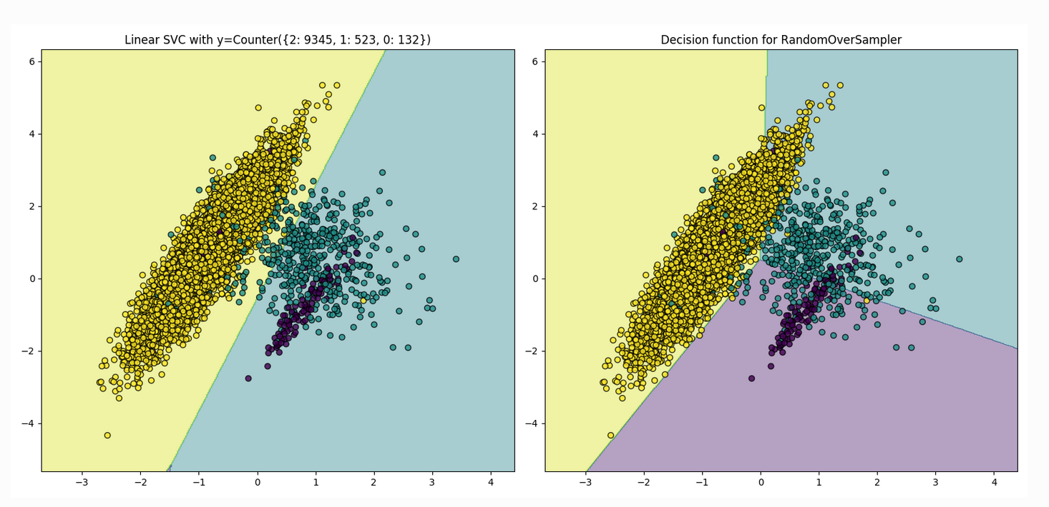
Naïve Random Oversampling

Slide 73
From Random Over Sampling to SMOTE and ADASYN
Two popular methods to over-sample minority classes:
The Synthetic Minority Oversampling Technique (SMOTE) [1]
The Adaptive Synthetic (ADASYN) sampling method [2]
[1] He, Haibo, Yang Bai, Edwardo A. Garcia, and Shutao Li. “ADASYN: Adaptive synthetic sampling approach for imbalanced learning,” In IEEE International Joint Conference on Neural Networks (IEEE World Congress on Computational Intelligence), pp. 1322-1328, 2008.
[2] N. V. Chawla, K. W. Bowyer, L. O.Hall, W. P. Kegelmeyer, “SMOTE: synthetic minority over-sampling technique,” Journal of artificial intelligence research, 16, 321-357, 2002.

Slide 74
From Random Over Sampling to SMOTE and ADASYN
While the RandomOverSampler is over-sampling by duplicating some of the original samples of the minority class, SMOTE and ADASYN generate new samples in by interpolation.
However, the samples used to interpolate/generate new synthetic samples differ.
ADASYN focuses on generating samples next to the original samples which are wrongly classified using a k-Nearest Neighbors classifier.
The ADASYN algorithm selects samples in accordance with a non uniform distribution.
The probability of choosing a particular example directly depends on the number of points in the nearest neighborhood belonging to other categories

Slide 75
From Random Over Sampling to SMOTE and ADASYN
The basic implementation of SMOTE will not make any distinction between easy and hard samples to be classified using the nearest neighbors rule.
Therefore, the decision function found during training will be different among the algorithms.

Slide 76
Original SMOTE Paper
SMOTE: Synthetic Minority Over-sampling Technique
https://arxiv.org/abs/1106.1813
SMOTE works by selecting examples that are close in the feature space, drawing a line between the examples in the feature space and drawing a new sample at a point along that line.
Specifically, a random example from the minority class is first chosen. Then k of the nearest neighbors for that example are found (typically k=5).
A randomly selected neighbor is chosen and a synthetic example is created at a randomly selected point between the two examples in feature space.

Slide 77
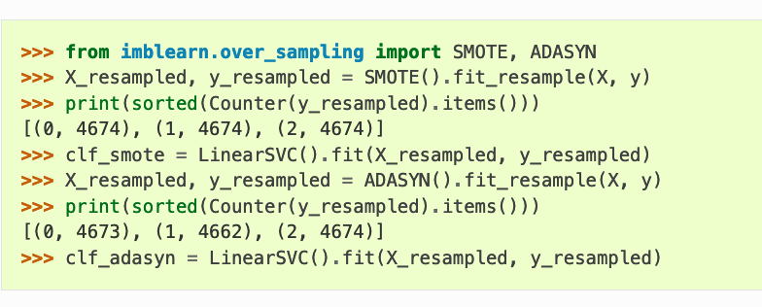
From Random Over Sampling to SMOTE and ADASYN

Slide 78
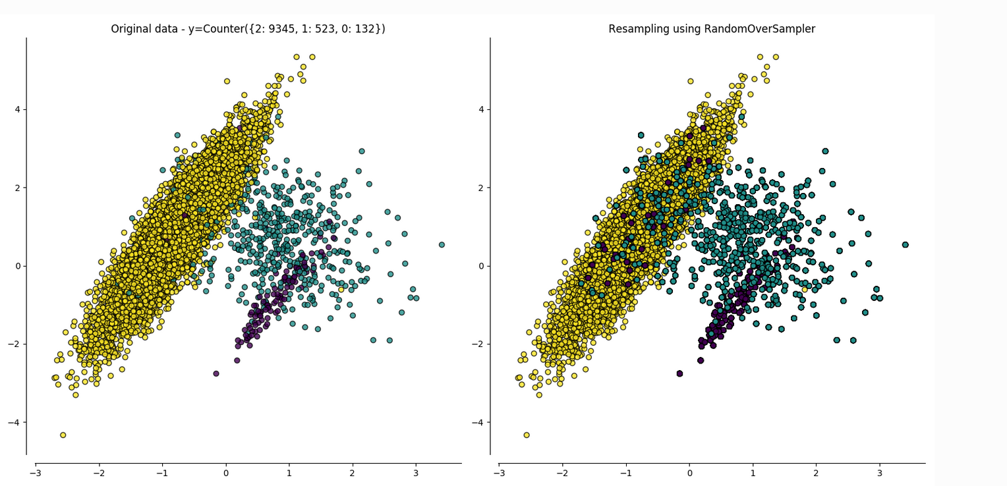
From Random Over-Sampling to SMOTE and ADASYN

Slide 79
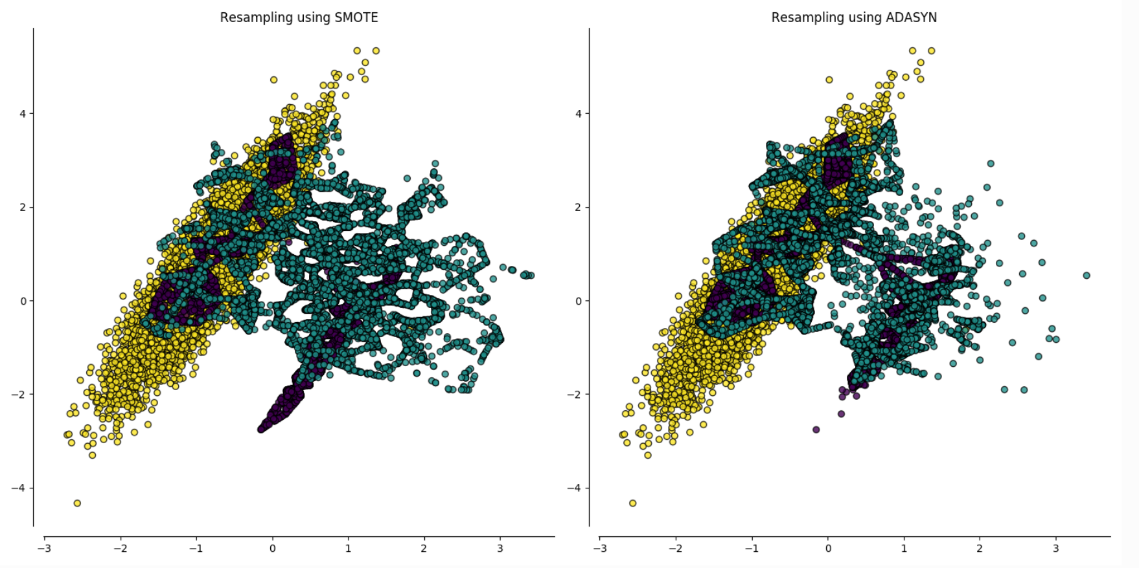
From Random Over Sampling to SMOTE and ADASYN

Slide 80
SMOTE Variants
SMOTE offers three additional options to generate samples.
Those methods focus on samples near of the border of the optimal decision function and will generate samples in the opposite direction of the nearest neighbors class.
BorderlineSMOTE
SVMSMOTE
KMeansSMOTE

Slide 81
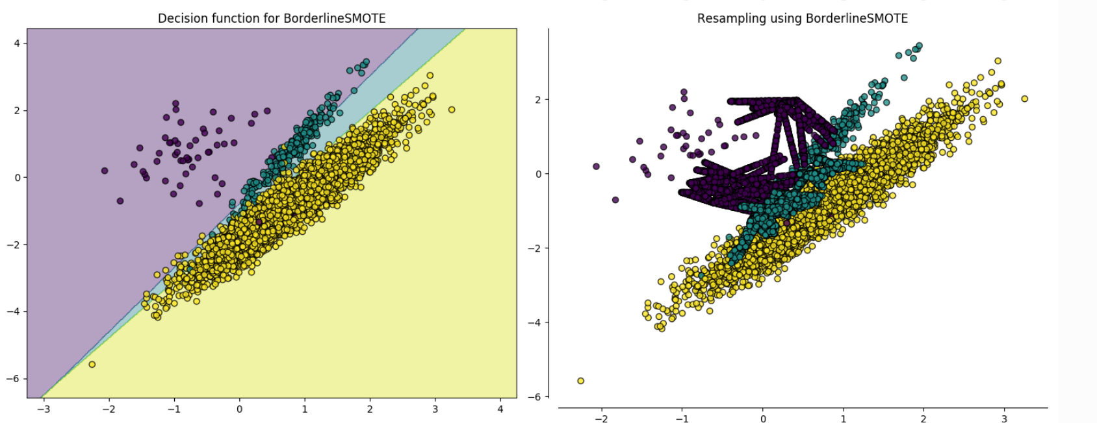
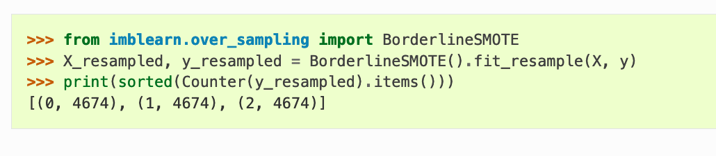
SMOTE Variants
The Borderline SMOTE works only with the samples lying on the boundary of the minority category

Slide 82
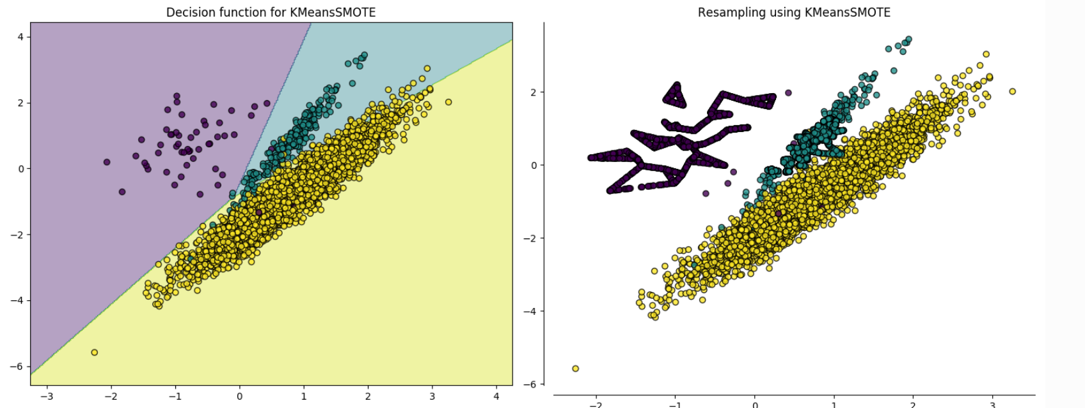
SMOTE Variants
Oversampling for Imbalanced Learning Based on K-Means and SMOTE
https://arxiv.org/abs/1711.00837

Slide 83
SMOTE Variants
K-means SMOTE consists of three steps: clustering, filtering, and oversampling.
In the clustering step, the input space is clustered into k groups using k-means clustering.
The filtering step selects clusters for oversampling, retaining those with a high proportion of minority class samples.
It then distributes the number of synthetic samples to generate, assigning more samples to clusters where minority samples are sparsely distributed.
Finally, in the oversampling step, SMOTE is applied in each selected cluster to achieve the target ratio of minority and majority instances.

Slide 84
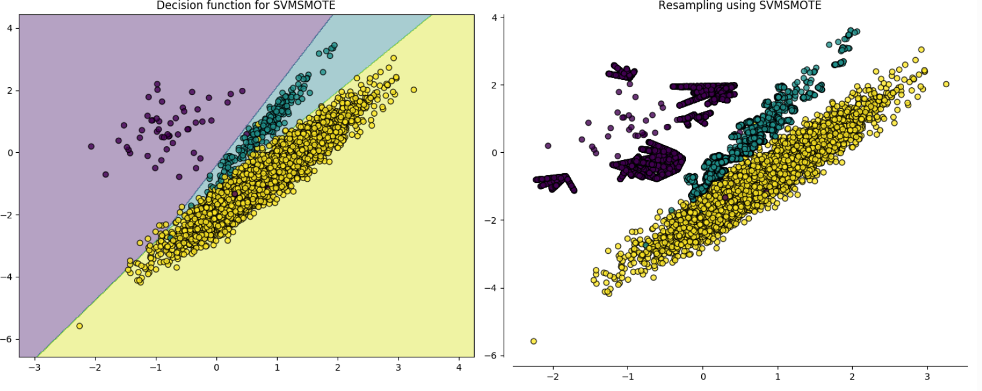
SMOTE Variants

Slide 85
SMOTE Variants
Hien Nguyen, et al. suggest using an alternative of Borderline-SMOTE where an SVM algorithm is used to identify misclassified examples on the decision boundary.
Their approach is summarized in the 2009 paper titled “Borderline Over-sampling For Imbalanced Data Classification.”
An SVM is used to locate the decision boundary defined by the support vectors and examples in the minority class that close to the support vectors become the focus for generating synthetic examples.

Slide 86
SMOTE – Practical Guidance
Research suggests first using random under-sampling to trim the number of examples in the majority class, then use SMOTE to oversample the minority class to balance the class distribution.
The combination of SMOTE and under-sampling performs better than plain under-sampling.
A general downside of the approach is that synthetic examples are created without considering the majority class, possibly resulting in ambiguous examples if there is a strong overlap for the classes.
https://machinelearningmastery.com/smote-oversampling-for-imbalanced-classification/

Slide 87
SMOTE for Text Classification
A Comparison of Synthetic Oversampling Methods for Multi-class Text Classification
https://arxiv.org/pdf/2008.04636.pdf
Text Representation
– Bag-of-Words
– Bag-of-Words + TFIDF
– Word2Vec.
Encode the sentences to some numeric values – generate features!

Slide 88
Summary
Sampling is not always useful.
Sometimes there is a loss of information.
Determining proper sample size is also very important.
People have started using adaptive or progressive sampling.
This approach starts with a small sample, and then increase the sample size until a sample of sufficient has been obtained.

Slide 89
Text Data Augmentation

Slide 90
Data Augmentation
Data Augmentation is a technique commonly used in increasing image data set size for image classification task.
It involves creating new images by transforming( Rotate, Translate or/and Scale, adding some noise) the ones in the data set.
The equivalent of transformation for text data when applying Data Augmentation, however, is tokenization of documents/texts to be augmented into sentences, shuffling those sentences and rejoin them to generate new texts.

Slide 91
Data Augmentation
More data we have, better performance we can achieve
Proper data augmentation is useful to boost up your model performance.
In natural language processing (NLP) field, it is hard to augmenting text due to high complexity of language.
https://towardsdatascience.com/data-augmentation-in-nlp-2801a34dfc28

Slide 92
Data Augmentation Methods
Thesaurus
Word Embeddings
Back Translation
Contextualized Word Embeddings
Text Generation
https://towardsdatascience.com/data-augmentation-in-nlp-2801a34dfc28

Slide 93
Data Augmentation Methods
Thesaurus
Zhang et al. introduced synonyms Character-level Convolutional Networks for Text Classification (https://arxiv.org/pdf/1509.01626.pdf)
During the experiment, they found that one of the useful way to do text augmentation is replacing words or phrases with their synonyms
Leverage existing thesaurus help to generate lots of data in a short time.
https://towardsdatascience.com/data-augmentation-in-nlp-2801a34dfc28

Slide 94
Data Augmentation Methods
Word Embeddings
Wang and Yang introduced word similarity calculation in That’s So Annoying!!!: A Lexical and Frame-Semantic Embedding Based Data Augmentation Approach to Automatic Categorization of Annoying Behaviors using #petpeeve Tweets (https://www.aclweb.org/anthology/D15-1306/)
In the paper, Wang and Yang proposed to use k-nearest-neighbor (KNN) and cosine similarity to find the similar word for replacement.

Slide 95

Data Augmentation Methods
Word Embeddings
Alternatively, we can leverage pre-trained classic word embeddings such as word2vec, GloVe and fasttext to perform similarity search.

Slide 96
Data Augmentation Methods
Back Translation
English is one of the language which having lots of training data for translation while some language may not have enough data for train a machine translation model.
Sennrich et al. used back-translation method to generate more training data to improve translation model performance.

Slide 97
Data Augmentation Methods
Back Translation
Given that we want to train a model for translating English (source language) → Cantonese (target language) and there is not enough training data for Cantonese.
Back-translation is translating target language to source language and mixing both original source sentence and back-translated sentence to train a model.
So the number of training data from source language to target language can be increased.

Slide 98

Data Augmentation Methods
Back Translation

Slide 99

Data Augmentation Methods
Contextualized Word Embeddings
Rather than using static word embeddings, Fadaee et al. use contextualized word embeddings to replace target word.
They use this text augmentation to validate machine translation model in Data Augmentation for Low-Resource Neural Machine Translation (https://arxiv.org/pdf/1705.00440.pdf).

Slide 100

Data Augmentation Methods
Contextualized Word Embeddings
Kobayashi propose to use a bi-directional language model in Contextual Augmentation: Data Augmentation by Words with Paradigmatic Relation (https://arxiv.org/pdf/1805.06201.pdf)
After selected target word, the model will predict possible replacement by giving surrounding words. As the target will exist in any position of sentence, bi-directional architecture is used to learn both rightward and leftward context.

Slide 101
Data Augmentation Methods
Text Generation
Kafle et al. introduced a different approach which generate augmented data by generating it in Data Augmentation for Visual Question Answering (https://www.aclweb.org/anthology/W17-3529/).
Different from previous approach, Kafle et al. approaches do not replace single of few words but generating the whole sentence.
First approach is using template augmentation which is using pre-defined question can using rule-based to generate an answer to pair with the template questions.
Second approach leverages LSTM to generate a question by providing image feature.

Slide 102

Data Augmentation Methods
Text Generation

Slide 103
Dealing with Outliers

Slide 104
Dealing with Outliers
There are certain things which, if are not done in the EDA phase, can affect further statistical/Machine Learning modelling.
One of them is finding “Outliers”.
In statistics, an outlier is an observation point that is distant from other observations.
https://towardsdatascience.com/ways-to-detect-and-remove-the-outliers-404d16608dba

Slide 105

Finding Outliers
We will be using Boston House Pricing Dataset which is included in the sklearn dataset API. We will load the dataset and separate out the features and targets.
https://towardsdatascience.com/ways-to-detect-and-remove-the-outliers-404d16608dba

Slide 106

Finding Outliers
Features/independent variable will be used to look for any outlier. Looking at the data above, it seems, we only have numeric values
https://towardsdatascience.com/ways-to-detect-and-remove-the-outliers-404d16608dba

Slide 107
Finding Outliers
There are two types of analysis we will follow to find the outliers-
Uni-variate(one variable outlier analysis)
Multi-variate(two or more variable outlier analysis)
https://towardsdatascience.com/ways-to-detect-and-remove-the-outliers-404d16608dba

Slide 108


Discover outliers with visualization tools
Box plot-
This plot shows three points between 10 to 12, these are outliers as there are not included in the box of other observation i.e no where near the quartiles.
https://towardsdatascience.com/ways-to-detect-and-remove-the-outliers-404d16608dba

Slide 109
Discover outliers with visualization tools
Here we analysed Uni-variate outlier i.e. we used DIS column only to check the outlier. But we can do multivariate outlier analysis too
Can we do the multivariate analysis with Box plot?
Well it depends, if you have a categorical values then you can use that with any continuous variable and do multivariate outlier analysis.
As we do not have categorical value in our Boston Housing dataset, we might need to forget about using box plot for multivariate outlier analysis.
https://towardsdatascience.com/ways-to-detect-and-remove-the-outliers-404d16608dba

Slide 110

Discover outliers with visualization tools
Scatter plot-
https://towardsdatascience.com/ways-to-detect-and-remove-the-outliers-404d16608dba

Slide 111

Discover outliers with visualization tools
Scatter plot-
Looking at the plot above, we can see most of data points are lying bottom left side but there are points which are far from the population like top right corner.
https://towardsdatascience.com/ways-to-detect-and-remove-the-outliers-404d16608dba

Slide 112
Discover outliers with mathematical function
Z-Score-
The Z-score is the signed number of standard deviations by which the value of an observation or data point is above the mean value of what is being observed or measured.
The intuition behind Z-score is to describe any data point by finding their relationship with the Standard Deviation and Mean of the group of data points.
Z-score is finding the distribution of data where mean is 0 and standard deviation is 1 i.e. normal distribution.
https://towardsdatascience.com/ways-to-detect-and-remove-the-outliers-404d16608dba

Slide 113
Z-Score
Z-Score-
Simply put, a z-score (also called a standard score) gives you an idea of how far from the mean a data point is.
But more technically it’s a measure of how many standard deviations below or above the population mean a raw score is.
A z-score can be placed on a normal distribution curve.
Z-scores range from -3 standard deviations
(which would fall to the far left of the normal distribution curve) up to
+3 standard deviations (which would fall to the far right of the normal distribution curve).
In order to use a z-score, you need to know the mean μ and also the population standard deviation σ.
https://www.statisticshowto.com/probability-and-statistics/z-score/

Slide 114
Z-Score
Z-Score-
Z-scores are a way to compare results to a “normal” population.
Results from tests or surveys have thousands of possible results and units; those results can often seem meaningless.
For example, knowing that someone’s weight is 150 pounds might be good information, but if you want to compare it to the “average” person’s weight, looking at a vast table of data can be overwhelming (especially if some weights are recorded in kilograms).
A z-score can tell you where that person’s weight is compared to the average population’s mean weight.
z = (x – μ) / σ
https://www.statisticshowto.com/probability-and-statistics/z-score/

Slide 115
Discover outliers with mathematical function
Z-Score-
How does this help in identifying the outliers?
While calculating the Z-score we re-scale and center the data and look for data points which are too far from zero.
These data points which are way too far from zero will be treated as the outliers.
In most of the cases a threshold of 3 or -3 is used i.e if the Z-score value is greater than or less than 3 or -3 respectively, that data point will be identified as outliers.
https://towardsdatascience.com/ways-to-detect-and-remove-the-outliers-404d16608dba

Slide 116


Discover outliers with mathematical function
Z-Score-
https://towardsdatascience.com/ways-to-detect-and-remove-the-outliers-404d16608dba

Slide 117

Discover outliers with mathematical function
Z-Score-
Looking the code and the output above, it is difficult to say which data point is an outlier. Let’s try and define a threshold to identify an outlier.
https://towardsdatascience.com/ways-to-detect-and-remove-the-outliers-404d16608dba

Slide 118

Discover outliers with mathematical function
Z-Score-
The first array contains the list of row numbers and second array respective column numbers, which mean z[55][1] have a Z-score higher than 3.

Slide 119

Discover outliers with mathematical function
Z-Score-
So, that data point is an outlier.
https://towardsdatascience.com/ways-to-detect-and-remove-the-outliers-404d16608dba

Slide 120
Discover outliers with mathematical function
IQR score -
Box plot use the IQR method to display data and outliers(shape of the data) but in order to be get a list of identified outlier, we will need to use the mathematical formula and retrieve the outlier data.
The interquartile range (IQR), also called the midspread or middle 50%, or technically H-spread, is a measure of statistical dispersion, being equal to the difference between 75th and 25th percentiles, or between upper and lower quartiles, IQR = Q3 − Q1.

Slide 121
Discover outliers with mathematical function
IQR score -
In other words, the IQR is the first quartile subtracted from the third quartile; these quartiles can be clearly seen on a box plot on the data.
It is a measure of the dispersion similar to standard deviation or variance, but is much more robust against outliers.

Slide 122
Discover outliers with mathematical function
IQR score -
IQR is somewhat similar to Z-score in terms of finding the distribution of data and then keeping some threshold to identify the outlier.
Let’s find out we can box plot uses IQR and how we can use it to find the list of outliers as we did using Z-score calculation. First we will calculate IQR

Slide 123


Discover outliers with mathematical function
IQR score -

Slide 124

Discover outliers with mathematical function
IQR score -
As we now have the IQR scores, it’s time to get hold on outliers. The below code will give an output with some true and false values.
The data point where we have False that means these values are valid whereas True indicates presence of an outlier.

Slide 125

Discover outliers with mathematical function
IQR score -
The data point where we have False that means these values are valid whereas True indicates presence of an outlier.

Slide 126
Removing Outliers
Now that we know how to detect the outliers, it is important to understand if they needs to be removed or corrected.
During data analysis when you detect the outlier one of most difficult decision could be how one should deal with the outlier.
Should they remove them or correct them?

Slide 127

Removing Outliers
Z-Score
We saw how one can detect the outlier using Z-score but now we want to remove or filter the outliers and get the clean data.
This can be done with just one line code as we have already calculated the Z-score.

Slide 128

Removing Outliers
IQR-Score
Just like Z-score we can use previously calculated IQR score to filter out the outliers by keeping only valid values.

Slide 129
Let’s Try the Code!

Slide 130
Modified Z-score
The Z-score method relies on the mean and standard deviation of a group of data to measure central tendency and dispersion.
This is troublesome, because the mean and standard deviation are highly affected by outliers – they are not robust.
In fact, the skewing that outliers bring is one of the biggest reasons for finding and removing outliers from a dataset!
http://colingorrie.github.io/outlier-detection.html

Slide 131
Modified Z-score
Another drawback of the Z-score method is that it behaves strangely in small datasets – in fact, the Z-score method will never detect an outlier if the dataset has fewer than 12 items in it.
This motivated the development of a modified Z-score method, which does not suffer from the same limitation

Slide 132

Modified Z-score

Slide 133
Removing Outliers: Another Example

Slide 134
Removing Outliers: Another Example
Remove Outliers Using Normal Distribution and S.D.
Approach is to remove the outlier points by eliminating any points that were above (Mean + 2*SD) and any points below (Mean - 2*SD) before plotting the frequencies.
arr = [10, 386, 479, 627, 20, 523, 482, 483, 542, 699, 535, 617, 577, 471, 615, 583, 441, 562, 563, 527, 453, 530, 433, 541, 585, 704, 443, 569, 430, 637, 331, 511, 552, 496, 484, 566, 554, 472, 335, 440, 579, 341, 545, 615, 548, 604, 439, 556, 442, 461, 624, 611, 444, 578, 405, 487, 490, 496, 398, 512, 422, 455, 449, 432, 607, 679, 434, 597, 639, 565, 415, 486, 668, 414, 665, 763, 557, 304, 404, 454, 689, 610, 483, 441, 657, 590, 492, 476, 437, 483, 529, 363, 711, 543]
https://www.kdnuggets.com/2017/02/removing-outliers-standard-deviation-python.html

Slide 135
Removing Outliers: Another Example
Remove Outliers Using Normal Distribution and S.D.
elements = numpy.array(arr)
mean = numpy.mean(elements, axis=0)
sd = numpy.std(elements, axis=0)
final_list = [x for x in arr if (x > mean - 2 * sd)]
final_list = [x for x in final_list if (x < mean + 2 * sd)]
print(final_list)
https://www.kdnuggets.com/2017/02/removing-outliers-standard-deviation-python.html

Slide 136
Other Methods
Outlier Removal Clustering
https://haridas.in/outlier-removal-clustering.html
Outlier Removal Clustering ( ORC ) is an improved version of KMean with outlier removal in each iteration.
As we all know that KMean is more sensitive with outliers, and might result into local optimal centroids.
For unsupervised clustering KMean is the mainly used algorithm because which is very effective as well as easy to implement.
For data which has lot of outliers still works well with KMean if we add outlier removal mechanism in each iteration of the KMean clustering.

Slide 137
Summary
Whether an outlier should be removed or not.
Every data analyst/data scientist might get these thoughts once in every problem they are working on.
Some good explanations exist
https://www.researchgate.net/post/When_is_it_justifiable_to_exclude_outlier_data_points_from_statistical_analyses
https://www.researchgate.net/post/Which_is_the_best_method_for_removing_outliers_in_a_data_set
https://www.theanalysisfactor.com/outliers-to-drop-or-not-to-drop/
To summarize their explanation- bad data, wrong calculation, these can be identified as Outliers and should be dropped but at the same time you might want to correct them too, as they change the level of data i.e. mean which cause issues when you model your data.

Slide 138
Discussion

Slide 139
Obtaining Data through Social Media APIs

Slide 140
Background
Researchers and practitioners have acquired social media data from different platforms such as Facebook and Twitter for various tasks such as personality prediction, values prediction, cognitive style prediction.
Online discussion forum data such as Reddit has been used for identifying and interpreting categories of words which are indicative of basic human values.

Slide 141
Social Media APIs
For data acquisition from these social media platforms, most often developers would use APIs offered by the platforms.
Twitter API: https://developer.twitter.com/en/docs
Facebook API: https://developers.facebook.com/
Instagram API: https://www.instagram.com/developer/
Tiktok API: https://developers.tiktok.com/
Reddit API: https://www.reddit.com/dev/api/
SnapChat API: https://kit.snapchat.com/
Software libraries are also available for easy access to such APIs.

Slide 142
Historical Content Volume
Social media platforms also apply constraint in terms of how much historical content available from a user’s timeline.
For example, Twitter allows only last 3200 tweets from a user’s timeline through API.
Social media APIs also apply authentication mechanism for getting access to data for a user.
Most often this is done through OAuth authentication mechanism where a client application registers with the social media platform and receives a consumer key and secret.

Slide 143
Use case for Developers
One important consideration for developers is to assess whether they need to access only public posts of users from their timeline or whether they need to access all posts.
For the first case, different social media platforms provide public feed APIs (e.g., https://developers.facebook.com/docs/public_feed/) where it is possible to extract public posts of a user without his or her explicit approval (i.e., without authentication).

Slide 144
Use case for Developers
For public posts and acquiring public posts through such APIs, a developer doesn’t need to pay special attention to data privacy.
This is because when a social media user makes a public post in a specific social media platform, they are already giving permission for that post to be seen by anyone (as per the terms and condition of that specific social media platform).

Slide 145
Use case for Developers
For the second case, a user needs to authenticate the API with their credentials so that the API can read and extract posts from their timeline.
In this data acquisition use case, the user gives specific permission to read and extract their posts.
However, in this case, a developer needs to obtain specific permission from the user for any intended use case of the data.

Slide 146
Use case for Developers
Terms and conditions of the specific use case of the data acquisition has to be made clear to the user so that no legal complications may arise at a later point.
For example, if user’s tweets are obtained to develop a personality model, this intended use has to be made clear to the user upfront.

Slide 147
API Features

Slide 148
API Features
REST Versus Streaming APIs
The Twitter API is available in two forms: REST and Streaming.
Most APIs are RESTful, but some real-time services offer streaming APIs.
Data from REST APIs can be accessed using the requests library.
With the requests library, you can GET and POST web requests—which is what REST APIs use to return matching data.
In the case of Twitter, the REST API allows you to query tweets, post tweets, and do most things Twitter allows via its website.

Slide 149
API Features
REST Versus Streaming APIs
A streaming API runs as a real-time service and listens for data relating to your query.
When you encounter a streaming API, you will likely want to use a library built to help manage data intake.

Slide 150
Rate Limits

Slide 151
Rate Limits
APIs often have rate limits, which restrict the amount of data a user can request over a period of time.
Rate limits are put in place by the API providers for several different reasons.
In addition to rate limiting, you may also encounter an API with limited access to data, particularly if the data relates to business interests
If everyone was allowed to have 100% of the data 100% of the time, this could cause the API servers to crash.
APIs will often have a rate limit for all users, as it’s easier to manage. Twitter’s API was once limited in such a way; however, with the launch of the Streaming API, the usage changed.

Slide 152
Rate Limits
Twitter’s Streaming API provides a constant stream of data, while the RESTAPI limits the number of requests you can make per 15-minute period.
For example, the most common Twitter request limit interval is fifteen minutes (https://developer.twitter.com/en/docs/twitter-api/v1/rate-limits).
If an endpoint has a rate limit of 900 requests/15-minutes, then up to 900 requests over any 15-minute interval is allowed.
Social media platforms also apply constraint in terms of how much historical content available from a user’s timeline.

Slide 153
Tiered Data Volumes

Slide 154

Tiered Data Volumes

Slide 155
Tiered Data Volumes
You might look at these options and think, “I need the firehose, because I have to have it all!”
But there are some things you should know before attempting to purchase access:
The firehose is a lot of data. When handling massive data, you need to scale your data wrangling. It will require numerous engineers and servers to even begin to query the dataset the firehose provides.
The firehose costs money—a few hundred thousand dollars a year. This doesn’t include the cost of the infrastructure you need to consume it (i.e., server space and database costs).

Slide 156
Tiered Data Volumes
Consuming the firehose is not something individuals do on their own—usually, a larger company or institution supports the costs.
Most of what you really need, you can get from the Spritzer

Slide 157
Discussion

